Slide 1

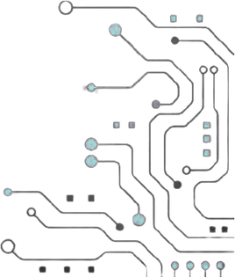




TEAM NAME:
NEXORA
PROBLEM STATEMENT NO: 16
PROBLEM STATEMENT TITLE: FPGA- Based Accident detection and GPS-SMS alert System
PS Category- Hardware

Slide 2
PROBLEM STATEMENT
Real-world problem
Accidents may go unreported when the driver cannot respond.
Emergency teams may not receive the accident location quickly.
Why it matters
Every second matters during emergency response.
Automatic location sharing can reduce response delays.
Current challenges
Impact does not always mean an accident.
Potholes, braking and vibrations can cause false triggers.
Single-sensor detection lacks reliability.

Slide 3
YOUR SOLUTION
Real-time accident validation using multi-sensor fusion with automatic GPS-SMS emergency alerts.
How it works
Detect → Validate → Decide → Locate → Alert
Monitors impact, acceleration & speed
250 ms event-validation window
70% impact-validation threshold
Acceleration + speed-drop analysis
FPGA performs real-time accident decision
ESP32 handles GPS & GSM communication

Slide 4
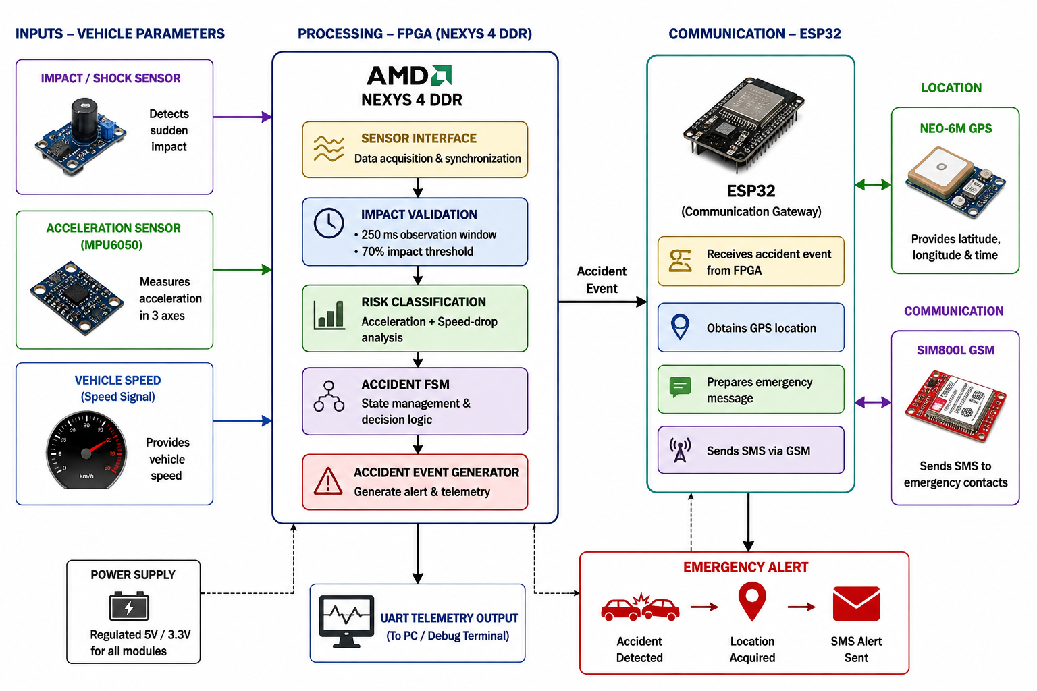
ARCHITECTURE BLOCK DIAGRAM

Slide 5
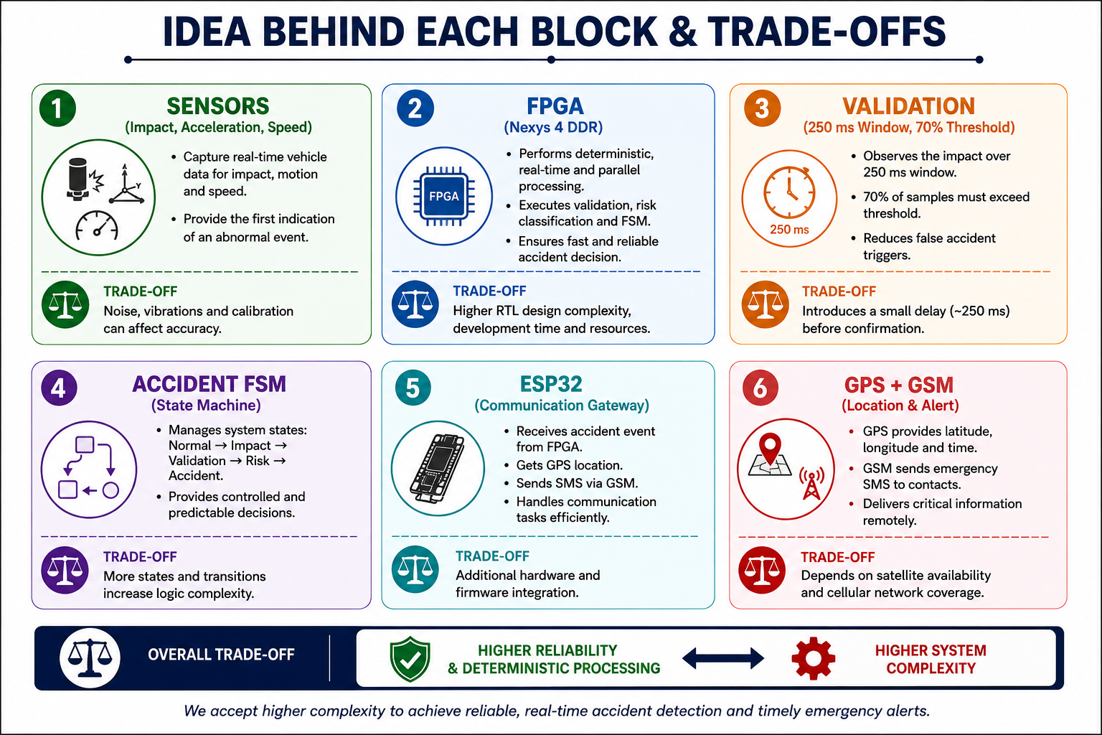

Slide 6
NOVELTY
WHAT MAKES NEXORA DIFFERENT?
From Impact Detection → Accident Validation
Multi-sensor fusion Shock + acceleration + speed
Temporal validation 250 ms observation window
Threshold-based validation 70% impact criterion
Combined accident analysis Acceleration + speed-drop
FPGA-based decision-making Real-time & deterministic processing
Separated communication layer ESP32 handles GPS + GSM

Slide 7
OUTPUTS AND RESULTS
Results
Impact Detection → 250 ms validation → 70% threshold evaluation
Accident Detection → Acceleration + speed-drop analysis
FPGA Verification → FSM verified → Risk classifier verified → UART telemetry verified
Emergency Output
GPS Location → GSM SMS Alert

Slide 8
RESEARCH AND REFERENCE
FPGA Based Accident Detection and Monitoring System for Safety Traffic — Fazal Noorbasha, K. D. M. Vikash Pani, K. Seetharam, S. Narendra
Accident Detection and Reporting System Using GPS, GPRS and GSM Technology — Md. Syedul Amin, Jubayer Jalil, M. B. I. Reaz
Automated Vehicle Accident Detection and Alert System Using GSM and GPS Technology — Nagesh Mahendra Ingle, Swapnil Bhika Billore, Yogesh Kumar, Shashank Kumar Singh, Anirban J. Hati
IoT Based Automatic Vehicle Accident Alert System — Nazia Parveen, Ashif Ali, Aleem Ali

